Slide 1

WEEK 3
CARBON CAPTURE AND STORAGE
Lecture 4

Slide 2

TOPIC OUTLINE
Direct Air Capture

Slide 3
INTRODUCTION
Direct air capture (DAC) is the use of chemical or physical processes to extract carbon dioxide directly from the ambient air. If the extracted CO2 is then sequestered in safe long-term storage (called direct air carbon capture and sequestration (DACCS)), the overall process will achieve carbon dioxide removal and be a "negative emissions technology" (NET).
The carbon dioxide (CO2) is captured directly from the ambient air; this is contrast to carbon capture and storage (CCS) which captures CO2 from point sources, such as a cement factory or a bioenergy plant. After the capture, DAC generates a concentrated stream of CO2 for sequestration or utilization or production of carbon-neutral fuel.

Slide 4
INTRODUCTION
Most commercial techniques require large fans to push ambient air through a filter. More recently, Ireland-based company Carbon Collect Limited has developed the MechanicalTree which simply stands in the wind to capture CO2. The company claims this 'passive capture' of CO2 significantly reduces the energy cost of Direct Air Capture, and that its geometry lends itself to scaling for gigaton CO2 capture.
Most commercial techniques use a liquid solvent—usually amine-based or caustic—to absorb CO2 from a gas. For example, a common caustic solvent: sodium hydroxide reacts with CO2 and precipitates a stable sodium carbonate. This carbonate is heated to produce a highly pure gaseous CO2 stream. Sodium hydroxide can be recycled from sodium carbonate in a process of causticizing. Alternatively, the CO2 binds to solid sorbent in the process of chemisorption.Through heat and vacuum, the CO2 is then desorbed from the solid.

Slide 5
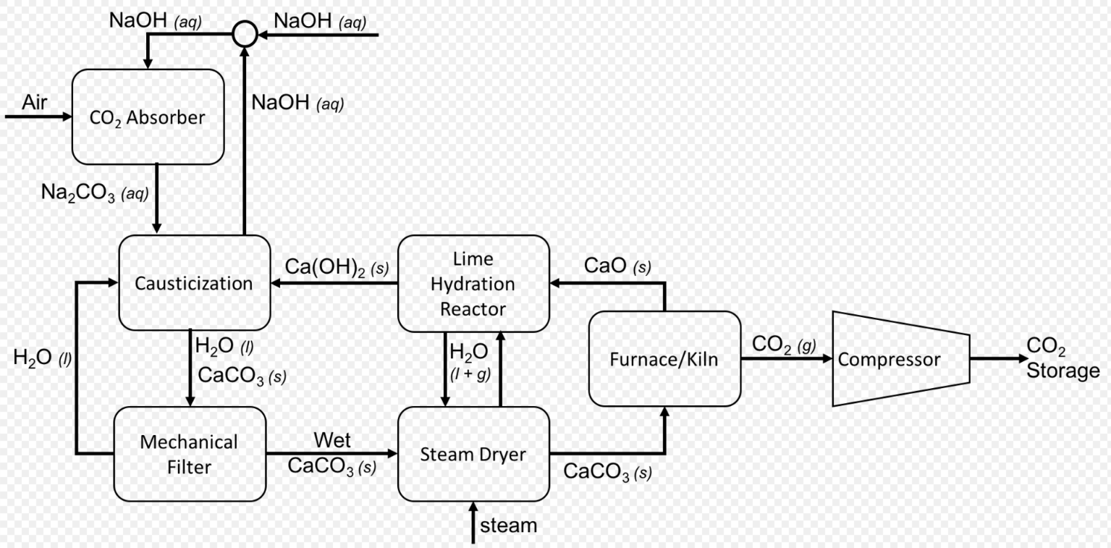
Flow diagram of direct air capture process using sodium hydroxide as the absorbent and including solvent regeneration

Slide 6
SOLID AND LIQUID DIRECT AIR CAPTURE
Solid DAC (S-DAC) is based on solid adsorbents operating through an adsorption/desorption cycling process. While the adsorption takes place at ambient temperature and pressure, the desorption happens through a temperature–vacuum swing process, where CO2 is released at low pressure7 and medium temperature (80-100°C). A single adsorption/desorption unit has a capture capacity of several tens of tonnes of CO2 per year (e.g. 50 tCO2/year) and can be used to extract water from the atmosphere where local conditions allow (early prototypes were able to remove around 1 tonne of water per tonne of CO2).8 An S-DAC plant is designed to be modular and can include as many units as needed. For instance, the largest operating S-DAC plant currently captures 4 000 tonnes of CO2 a year.

Slide 7
SOLID AND LIQUID DIRECT AIR CAPTURE
Liquid DAC (L-DAC) is based on two closed chemical loops. The first loop takes place in a unit called the contactor, which brings atmospheric air into contact with an aqueous basic solution (such as potassium hydroxide) capturing CO2. The second loop releases the captured CO2 from the solution in a series of units operating at high temperature (between 300°C and 900°C). A large-scale L-DAC plant can capture around 1 MtCO2/year from the atmosphere. Water top-up may be required depending on local weather conditions. For instance, around 4.7 tonnes of water per tonne of captured CO2 would be required for this plant configuration at ambient conditions of 64% relative humidity and 20°C.

Slide 8
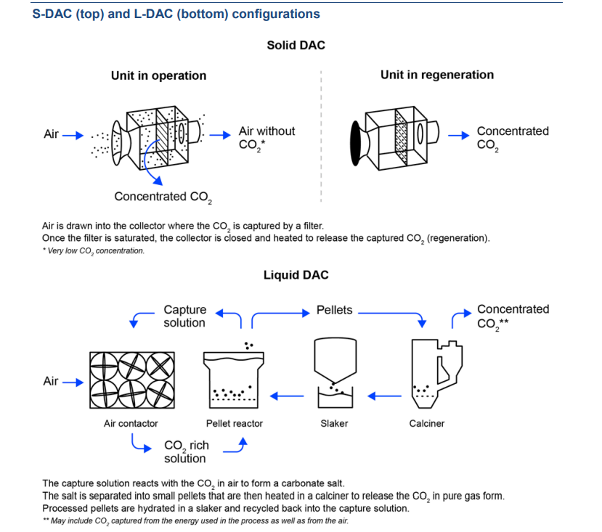

Slide 9
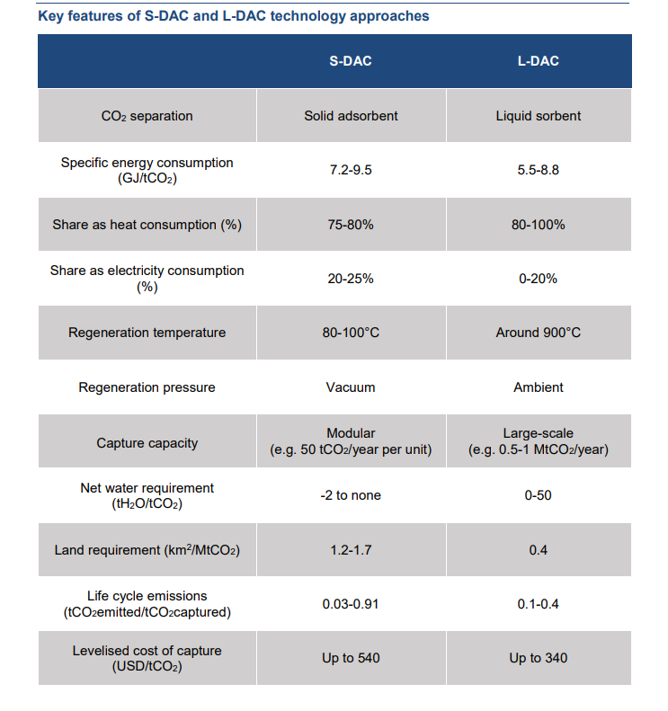

Slide 10
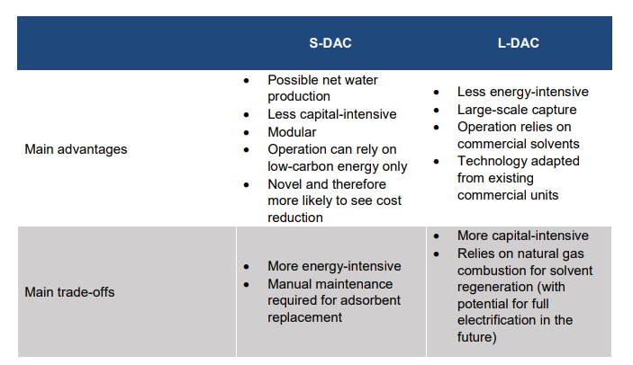

Slide 11
CARBON FOOTPRINTS AND COST OF CARBON REMOVAL
Reducing the environmental impact of DAC during its construction, commissioning, operation and decommissioning is of paramount importance to optimise the value of this technology as a climate mitigation solution.
This is why it makes little sense to power DAC using anything other than low-carbon energy sources. While not all DAC plants will be focused on carbon removal (some may supply CO2 for use), the potential for a DAC plant to effectively remove CO2 is not guaranteed and will depend on -
1) whether the CO2 is permanently stored, and
2) whether the emissions from DAC construction, commissioning, operation and decommissioning are lower than the CO2 emissions captured and removed from the atmosphere over the lifespan of the plant.

Slide 12
CARBON FOOTPRINTS AND COST OF CARBON REMOVAL
Life cycle assessment (LCA) is needed to quantify the amount of carbon removed (if any) by DAC technologies.22 LCA is a cradle-to-grave or cradle-to-cradle analysis technique to assess environmental impacts associated with “all the stages of a product’s life, which is from raw material extraction through materials processing, manufacture, distribution, and use”.
The result depends on a number of factors, which include, for instance, the choice of the reference system and its boundaries, the quantification of changes in land management and use, and the timing of emissions and removals.

Slide 13
CARBON FOOTPRINTS AND COST OF CARBON REMOVAL
Most life cycle assessment (LCA) studies on carbon dioxide removal (CDR) technologies focus on BECCS or biochar production. Limited studies on direct air capture (DAC) show that DAC with storage (DACS) is carbon negative, while DAC for CO₂ use can be carbon reducing if powered by low-carbon energy.
For DACS using natural gas and grid electricity, carbon removal efficiency ranges from over 60% to around 90%. With low-carbon heat sources and renewable electricity, efficiency can reach up to 97%, depending on the carbon intensity of the regional electricity grid

